Slide 1
OAuth Intro

Slide 2
What is OAuth?

Slide 3
Authentication & Authorization
Authentication is to prove someone is who they claim to be
Authorization is about specifying and controlling access to certain types of resources

Slide 4
What is OAuth2
OAuth2 is a delegation protocol.
a means of letting someone who controls a resource allow a software application to access that resource on their behalf without impersonating them

Slide 6
What is Oauth?
According to the spec:
“The OAuth 2.0 authorization framework enables a third-party application to obtain limited access to an HTTP service, either on behalf of a resource owner by orchestrating an approval interaction between the resource owner and the HTTP service, or by allowing the third-party application to obtain access on its own behalf. ”

Slide 7
Roles
Resource Owner:
Has access to API and can delegate access to that API. Usually a person with browser.
Protected Resource:
The component that Resource Owner has access to.
Many different form, but mostly web APIs
Client:
The piece of software that accesses the protected resource on behalf of the resource owner.

Slide 8
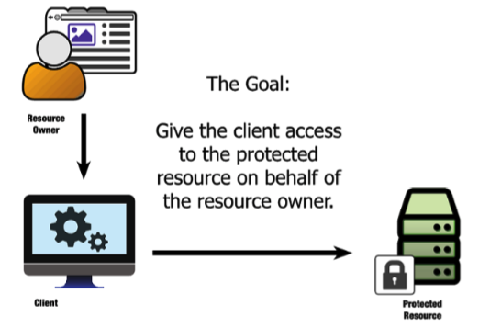

Slide 9
Before OAuth
Bad old days: credential sharing
Problems:
Application needs to store those credentials so as to pass them to server, which increases risk
If there is another server, either the user has the same account or the application needs to store multiple sets of credentials for the user
What if the user no longer wants the application to be able to access his data? Since the application has user’s credential, the user will need to change it
Every application and every server will need to store copies of every user’s credentials, this will be complex to manage

Slide 10
With OAuth – Delegating Access
In OAuth, the end user delegates some part of their authority to access the protected resource to the client application to act on their behalf.
To make that happen, OAuth introduces another component into the system: the authorization server

Slide 11
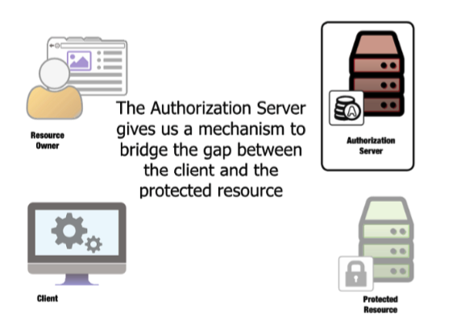

Slide 12
Authorization Server
The authorization server (AS) is trusted by the protected resource to issue special-purpose security credentials—called OAuth access tokens—to clients.

Slide 13
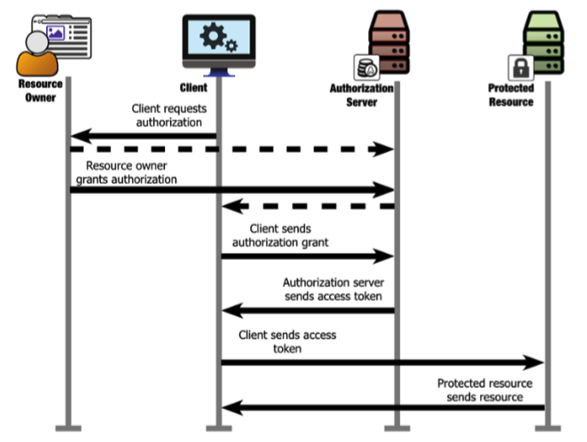

Slide 14
What OAuth 2.0 isn’t
OAuth isn’t defined outside of the HTTP protocol.
HTTPS is a must
Oauth isn’t an authentication protocol.
Oauth doesn’t define authorization-processing mechanism.
Oauth doesn’t define a Token format.
But the content of the token is completely opaque to the client application
Oauth doesn’t define cryptographic method.

